Slide 1
Module 1: Internetworking
Lesson 3: PCAP File Format

Slide 2
Internetworking Module
Module Description: ​
The intent of this Knowledge Unit is to provide students with an understanding of networking and internet protocols.
Topics:​
Lesson 1: Networking Overview​
Lesson 2: Internetworking
Lesson 3: PCAP File Format

Slide 3
Learning Outcomes
Upon completion of this lesson:
Students will be able to describe the PCAP file format.
Students will be able to read and interpret the contents of a PCAP file.

Slide 4
PCAP
PCAP is a common data format used to store captured network traffic. The format comes from the libpcap library, used by the TcpDump and WinDump programs
http://www.tcpdump.org is official website
PCAP file format is used by many network monitoring tools including Wireshark
http://www.wireshark.org

Slide 5
PCAP File Format
Global Header | Packet 0 Header | Packet 1 Data | Packet 1 Header | Packet 1 Data | . . . | Packet n Header
Global Header Format:
typedef struct pcap_hdr_s {
guint32 magic_number; /* magic number */
guint16 version_major; /* major version number */
guint16 version_minor; /* minor version number */
gint32 thiszone; /* GMT to local correction */
guint32 sigfigs; /* accuracy of timestamps */
guint32 snaplen; /* max length of captured packets, in octets */
guint32 network; /* data link type */
} pcap_hdr_t;
octet is an 8 bit data value
guintnn means an unsigned integer that is exactly nn bits on all platforms.

Slide 6
PCAP global header fields (1)
magic_number:
Used for file format and byte ordering for header fields
Application creating PCAP file writes 0xa1b2c3d4 with it's native byte ordering format into this field.
Reading application will read either 0xa1b2c3d4 (identical) or 0xd4c3b2a1 (swapped).
If reading application reads the swapped 0xd4c3b2a1 value, it knows that all the following fields will have to be swapped too.
For nanosecond-resolution files (libpcapv1.5)
writing application writes 0xa1b23c4d, with the two nibbles of the two lower-order bytes swapped,
reading application will read either 0xa1b23c4d (identical) or 0x4d3cb2a1 (swapped).

Slide 7
PCAP global header fields (2)
version_major, version_minor:
version number of file format (current version is 2.4)
thiszone:
correction time in seconds between GMT (UTC) and the local timezone of the packet header timestamps.
Examples:
If the timestamps are in GMT (UTC), thiszone is simply 0.
If the timestamps are in Central European time (Amsterdam, Berlin, ...) which is GMT + 1:00, thiszone must be -3600.
In practice, time stamps are always in GMT, so thiszone is always 0.
sigfigs:
in theory, the accuracy of time stamps in the capture; in practice, all tools set it to 0

Slide 8
PCAP global header fields (3)
snaplen:
“snapshot length” for the capture (typically 65535 or even more, but might be limited by the user),
see: incl_len vs. orig_len in record header
network:
link-layer header type, specifying the type of headers at the beginning of the packet
1 for Ethernet (layer two frame), 9 for PPP, 51 for PPPoE
see tcpdump.org's link-layer header types page for complete list

Slide 9
Active learning
Look at the contents of a pcap file using a binary editor, hex editor etc. Find the header fields.
Linux ‘hd’ ‘od’ or ‘hexdump’ are usually available.
Windows (can use a hexedit plugin for notepad++)

Slide 10
PCAP record (packet) header
typedef struct pcaprec_hdr_s {
guint32 ts_sec; /* timestamp seconds */
guint32 ts_usec; /* timestamp
microseconds */
guint32 incl_len; /* number of octets of
packet saved in file */
guint32 orig_len; /* actual length of
packet in octets) */
} pcaprec_hdr_t;
* octet is an 8-bit data value * guintnn means an unsigned integer that is exactly nn bits on all platforms.

Slide 11
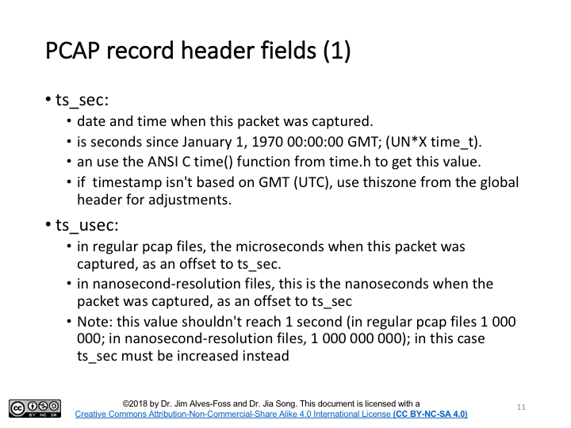
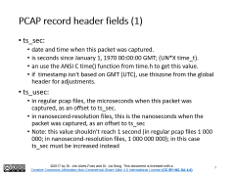
PCAP record header fields (1)
ts_sec:
date and time when this packet was captured.
is seconds since January 1, 1970 00:00:00 GMT; (UN*X time_t).
an use the ANSI C time() function from time.h to get this value.
if timestamp isn't based on GMT (UTC), use thiszone from the global header for adjustments.
ts_usec:
in regular pcap files, the microseconds when this packet was captured, as an offset to ts_sec.
in nanosecond-resolution files, this is the nanoseconds when the packet was captured, as an offset to ts_sec
Note: this value shouldn't reach 1 second (in regular pcap files 1 000 000; in nanosecond-resolution files, 1 000 000 000); in this case ts_sec must be increased instead

Slide 12
PCAP record header fields (2)
incl_len:
number of bytes of packet data actually captured and saved in the file.
value should never become larger than orig_len or the snaplen value of the global header.
orig_len:
length of the packet as it appeared on the network when captured.
if incl_len and orig_len differ, the saved packet size was limited by snaplen; and data was lost.

Slide 13
Packet data
Following record header will be incl_len octets of data.
There will be no specific byte alignment.
Data will be stored in network byte order (big endian), regardless of the endianness of the headers.
See specific protocol standards for details of network protocol formats.

Slide 14
Example TCP/IP packet over ethernet
Ethernet header | IP Header | TCP Header | User data . . . | Ethernet Frame Check Sequence

Slide 15
Transport Layer
IPv4 Protocol Header
Version
IHL
Type of Service
Total Length
Identification
Flags
Fragment Offset
Time to live
Protocol
Header Checksum
Source Address
Destination Address
Options
Padding
32 bits
4 bits

Slide 16
Transport Layer
TCP Protocol Data Unit
Source Port
Destination Port
Sequence Number
Acknowledgment Number
Offset
Reserved
Flags
Window
Checksum
Urgent Pointer
Options
Padding
32 bits

Slide 17
Please attribute Dr. Jim Alves-Foss and Dr. Jia Song, University of Idaho
Except where otherwise noted, this work is licensed under https://creativecommons.org/licenses/by-nc-sa/4.0/ Not withstanding the non-commercial license terms, non-profit educational institutions are granted a non-exclusive license to adapt and use this material, with attribution. Creative Commons and the double C in a circle are registered trademarks of Creative commons in the United States and other countries. Third party marks and brands are the property of their respective holders.
Project sponsored by the National Security Agency under grant Number H98230-17-1-0199. The United States Government is authorized to reproduce and distribute reprints notwithstanding any copyright notation herein.

